Slide 1

EXPERT SYSTEM
RAKesh Raja K B
ARUL VIGNESH P
RaMAN TU

Slide 2


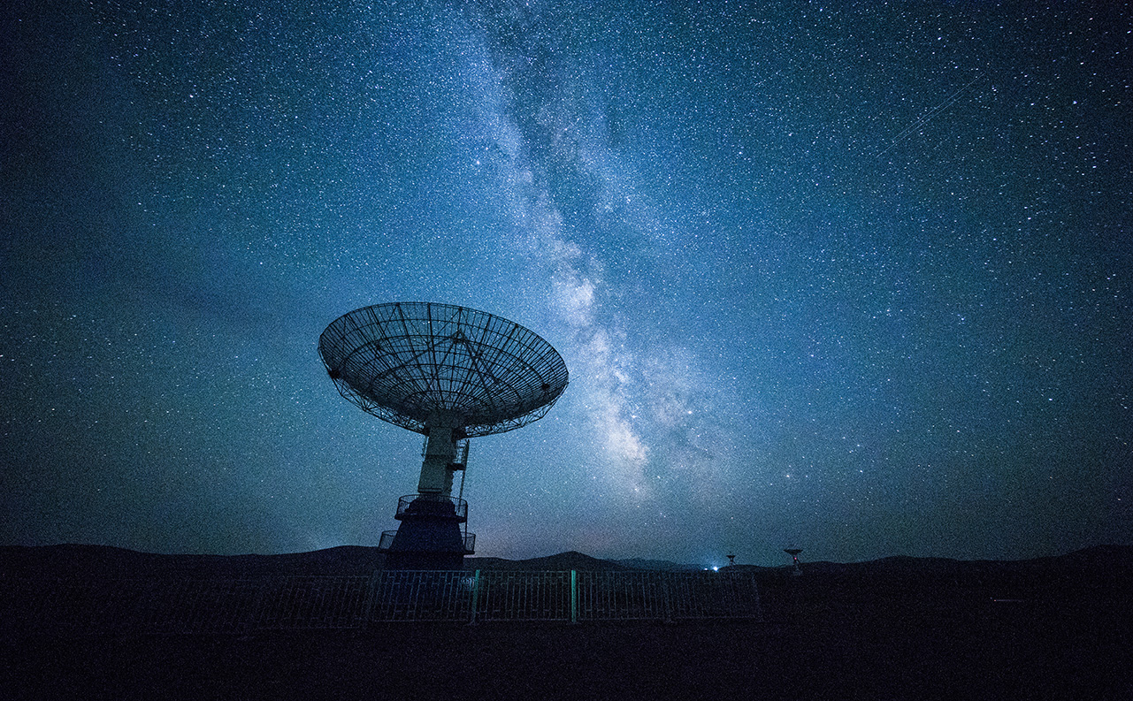
What is an Expert System?
An expert system is a computer program that is designed to solve complex problems and to provide decision-making ability like a human expert. It performs this by extracting knowledge from its knowledge base using the reasoning and inference rules according to the user queries.
The expert system is a part of AI, and the first ES was developed in the year 1970, which was the first successful approach of artificial intelligence. It solves the most complex issue as an expert by extracting the knowledge stored in its knowledge base. The system helps in decision making for compsex problems using both facts and heuristics like a human expert. It is called so because it contains the expert knowledge of a specific domain and can solve any complex problem of that particular domain. These systems are designed for a specific domain, such as medicine, science, etc.

Slide 3
Below is the block diagram that represents the working of an expert system:

Slide 4
some popular examples of the Expert System:
DENDRAL: It was an artificial intelligence project that was made as a chemical analysis expert system. It was used in organic chemistry to detect unknown organic molecules with the help of their mass spectra and knowledge base of chemistry.
MYCIN: It was one of the earliest backward chaining expert systems that was designed to find the bacteria causing infections like bacteraemia and meningitis. It was also used for the recommendation of antibiotics and the diagnosis of blood clotting diseases.
PXDES: It is an expert system that is used to determine the type and level of lung cancer. To determine the disease, it takes a picture from the upper body, which looks like the shadow. This shadow identifies the type and degree of harm.
CaDeT: The CaDet expert system is a diagnostic support system that can detect cancer at early stages.

Slide 5
Components of Expert System
Inference Engine
User Interface
Knowledge Base

Slide 6
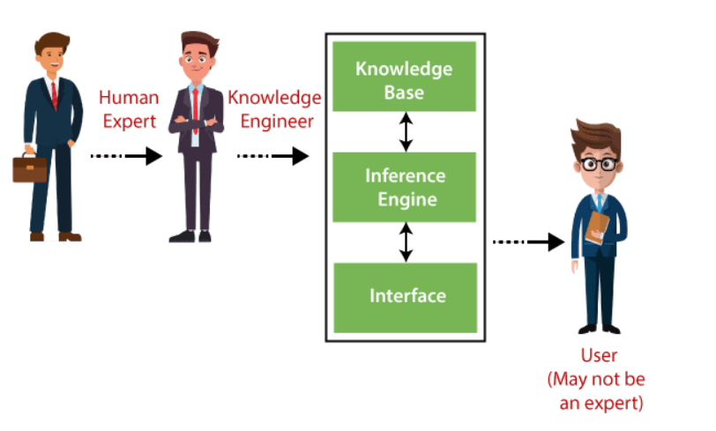

Slide 7
Characteristics of Expert System
High Performance: The expert system provides high performance for solving any type of complex problem of a specific domain with high efficiency and accuracy.
Understandable: It responds in a way that can be easily understandable by the user. It can take input in human language and provides the output in the same way.
Reliable: It is much reliable for generating an efficient and accurate output.
Highly responsive: ES provides the result for any complex query within a very short period of time.

Slide 8
Capabilities of the Expert System
Advising: It is capable of advising the human being for the query of any domain from the particular ES.
Provide decision-making capabilities: It provides the capability of decision making in any domain, such as for making any financial decision, decisions in medical science, etc.
Demonstrate a device: It is capable of demonstrating any new products such as its features, specifications, how to use that product, etc.
Problem-solving: It has problem-solving capabilities.
Explaining a problem: It is also capable of providing a detailed description of an input problem.
Interpreting the input: It is capable of interpreting the input given by the user.
Predicting results: It can be used for the prediction of a result.
Diagnosis: An ES designed for the medical field is capable of diagnosing a disease without using multiple components as it already contains various inbuilt medical tools.

Slide 9
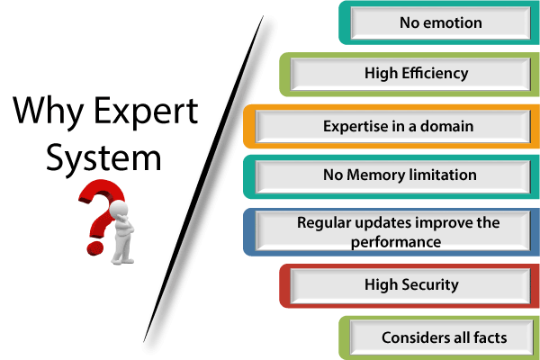
Why Expert System?

Slide 10
Advantages of Expert System
These systems are highly reproducible.
They can be used for risky places where the human presence is not safe.
Error possibilities are less if the KB contains correct knowledge.
The performance of these systems remains steady as it is not affected by emotions, tension, or fatigue.
They provide a very high speed to respond to a particular query.

Slide 11
Limitations of Expert System
The response of the expert system may get wrong if the knowledge base contains the wrong information.
Like a human being, it cannot produce a creative output for different scenarios.
Its maintenance and development costs are very high.
Knowledge acquisition for designing is much difficult.
For each domain, we require a specific ES, which is one of the big limitations.
It cannot learn from itself and hence requires manual updates.

Slide 12
Applications of Expert System
In designing and manufacturing domain It can be broadly used for designing and manufacturing physical devices such as camera lenses and automobiles.
In the knowledge domain These systems are primarily used for publishing the relevant knowledge to the users. The two popular ES used for this domain is an advisor and a tax advisor.
In the finance domain In the finance industries, it is used to detect any type of possible fraud, suspicious activity, and advise bankers that if they should provide loans for business or not.
In the diagnosis and troubleshooting of devices In medical diagnosis, the ES system is used, and it was the first area where these systems were used.
Planning and Scheduling The expert systems can also be used for planning and scheduling some particular tasks for achieving the goal of that task.

Slide 13

Thank You!

